Slide 1
Monitoring Enterococcus and its antimicrobial resistance in the Upper Oconee Watershed
Sohyun Cho (Gabi)
Frye Lab

Slide 2
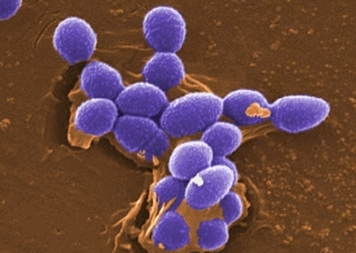
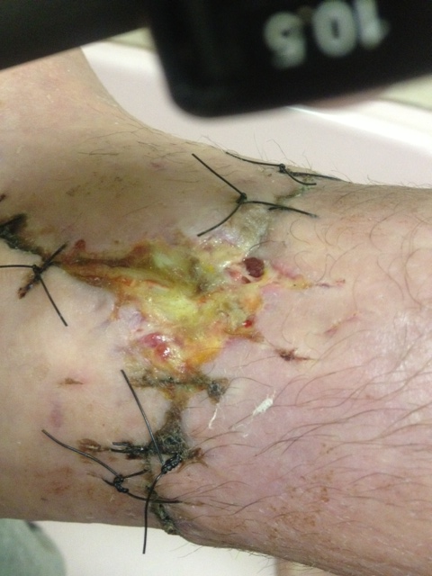
Why Enterococcus?
Commensal yet opportunistic pathogen
A leading cause of nosocomial infections
  12% of hospital-associated infections yearly in the US
  E. faecalis and E. faecium
Potential reservoir of resistance
  Intrinsic resistance
  Acquired resistance
    Mobile genetic elements such as plasmid
    and transposons
microbeworld.org
Magnapulse.com

Slide 3
Why study Enterococcus?
To assess water quality
To understand AR in the environment
To understand if surface water plays a role in the transmission of Enterococcus

Slide 4
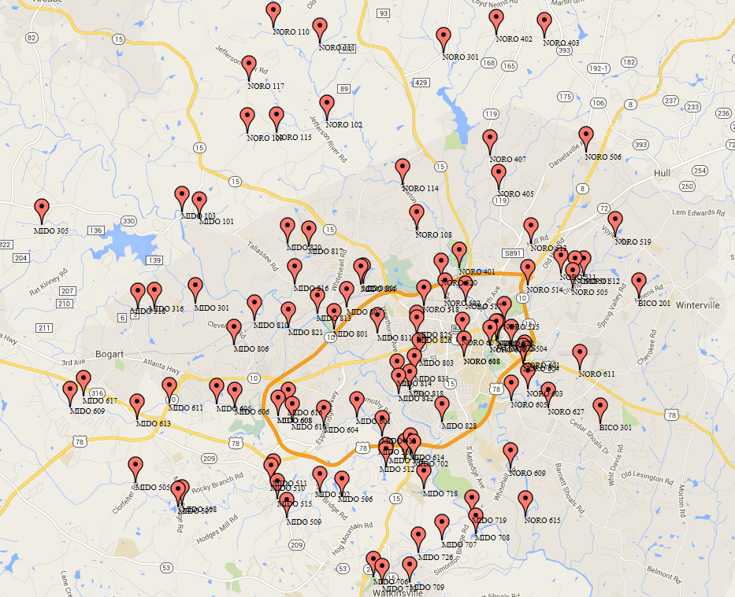
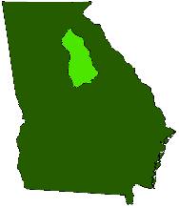
Sampling
Collected quarterly through a partnership with Upper Oconee Watershed Network (UOWN)
http://www.uown.org/images/upper_oconee_watershed_large.png

Slide 5
Sampling
Collected quarterly through a partnership with Upper Oconee Watershed Network (UOWN)
routine sites ( )
http://www.uown.org/images/upper_oconee_watershed_large.png

Slide 6
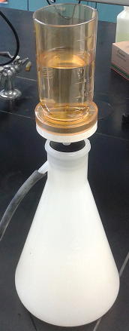
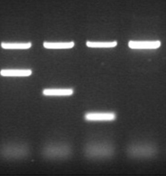
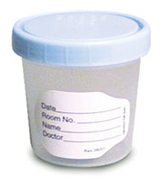
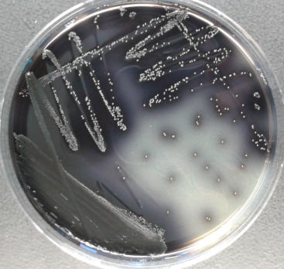
Processing
Filtration
Non-Selective
Pre-enrichment
Selective
Isolation
Characterization
BPW
Enterococcosel agar

Slide 7
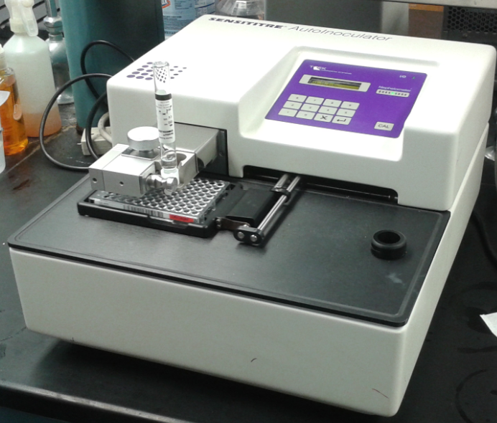
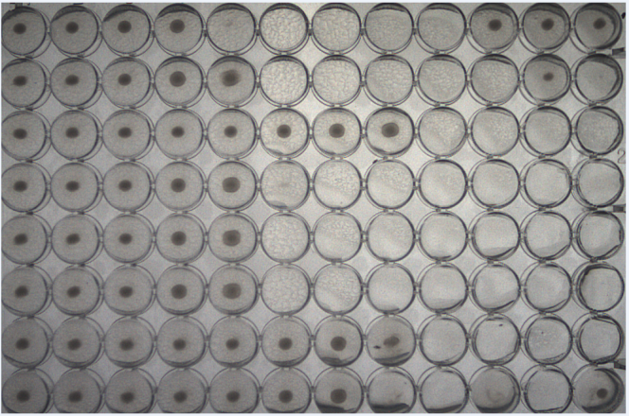

Antimicrobial Resistance (AR) Typing
Broth-microdilution method
Auto-inoculator
Susceptibility panel

Slide 8
Results
Sampling season | Positive sites | No. of Enterococcus Isolates Recovered
Winter 2015 | 29 (96.7%) | 58*
(N= 30)
Spring 2015 | 93 (93.0%) | 93
(N= 100)
Summer 2015 | 33 (100.0%) | 196*
(N= 33)
Fall 2015 | 58 (98.3%) | 58
(N= 59)
Winter 2016 | 41 (100.0%) | 41
(N= 41)
Spring 2016 | 87 (100.0%) | 87
(N= 87)
* More than one isolate obtained due to the use of several media

Slide 9
Enterococcus Speciation Result
11.8 %
46.6 %
11.5%
29.3%
19.0%
65.6%
20.4 %
43.1 %
35.6 %
12.2 %
N= 58 N= 93 N= 196 N= 58 N= 41 N= 87

Slide 10
Enterococcus Speciation Result
1.7%
14.0%
1.7 %
1.2%
7.1%
32.2%
12.2%
20.7%
9.8%
22.4%
39.3%
N= 58 N= 93 N= 196 N= 58 N= 41 N= 87

Slide 11
Antimicrobial Resistance in Enterococcus
Class | Antimicrobials | % of Resistant Enterococcus Isolates
 |  | Winter 2015 | Spring 2015 | Summer 2015 | Fall 2015 | Winter 2016 | Spring 2016
aminoglycosides | gentamicin | 0.0 | 0.0 | 0.0 | 0.0 | 0.0 | 0.0
 | kanamycin | 1.7 | 1.1 | 1.0 | 0.0 | 0.0 | 0.0
 | streptomycin | 1.7 | 1.1 | 0.0 | 0.0 | 0.0 | 2.4
macrolide | erythromycin | 1.7 | 1.1 | 2.0 | 0.0 | 0.0 | 1.1
 | tylosin (tartrate/base) | 6.9 | 2.2 | 2.0 | 0.0 | 0.0 | 1.1
fluoroquinolones | ciprofloxacin | 19.0 | 4.3 | 1.5 | 17.2 | 2.4 | 8.0
glycopeptide | vancomycin | 0.0 | 0.0 | 0.0 | 0.0 | 0.0 | 0.0
glycylcycline | tigecycline | 0.0 | 6.5 | 0.0 | 31.0 | 0.0 | 0.0
lipopeptides | daptomycin | 24.1 | 1.1 | 12.2 | 0.0 | 17.1 | 4.6
lincosamide | lincomycin | 91.4 | 95.7 | 85.2 | 94.8 | 82.9 | 97.7
nitrofurantoins | nitrofurantoin | 0.0 | 0.0 | 0.0 | 0.0 | 0.0 | 0.0
oxazolidinone | linezolid | 0.0 | 0.0 | 0.0 | 0.0 | 0.0 | 0.0
β-lactam | penicillin | 0.0 | 0.0 | 1.0 | 0.0 | 0.0 | 0.0
phenicols | chloramphenicol | 0.0 | 1.1 | 0.0 | 0.0 | 0.0 | 0.0
streptogramin | quinupristin/ dalfopristin | 13.3 | 7.5 | 0.5 | 8.8 | 0.0 | 2.3
tetracycline | tetracycline | 19.0 | 8.6 | 17.3 | 5.2 | 14.6 | 9.2
Notes:
.

Slide 12
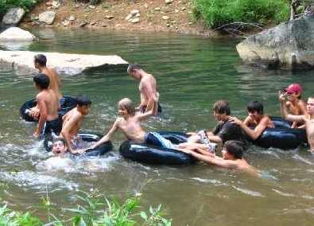
Conclusion
Enterococcus is prevalent in the Upper Oconee Watershed
There is a high level of antimicrobial resistance in Enterococcus
http://www.abramscreek.com/events2009.html

Slide 13
Future Research
Phenotypic and genotypic profiling of isolates from more water samples
Determination of AR genes and the associated mobile genetic elements e.g. plasmids, integrons
Statistical analysis to assess the geographical and temporal effects on the prevalence and diversity of enterococci

Slide 14
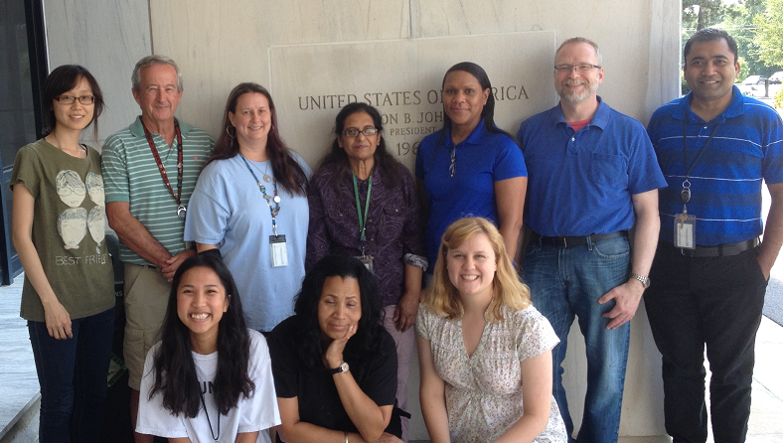



Acknowledgement
Frye Lab & Jackson Lab
USDA- BEAR unit
- Sandra House
- Calvin Williams
UOWN
Funding:
- ARS 6040-32000-006-00

